Slide 1

NetScanner - Automated Network
Enumeration and Vulnerability Analysis Tool
Guide
Dr J.Naskath, ASSO PROF/CSE
Team Members
MS S.Sarikha RegNo : 2212012 3rd Year CSE
Ms R.Sri Gomathi RegNo : 2212013 3rd Year CSE
MS S.Aruna Varshini RegNo : 2212019 3rd Year CSE
1
08/03/2025

Slide 2

CONTENT
Customer Need Identification
Product Based Survey
Problem Definition
Concept Development
Implementation (40%)
2
08/03/2025

Slide 3
1. CUSTOMER NEED IDENTIFICATION
Nmap is difficult for non-technical users: It’s complex and requires command-line knowledge.
Manual scanning is time-consuming and error-prone: Users need an easier, automated solution.
Need for a simple, user-friendly web tool: To make scanning and vulnerability detection more accessible.
Limited Customization: Users struggle to choose the right scan options.
No Scan History: Nmap doesn’t store past scan results for easy reference.
3
08/03/2025

Slide 4
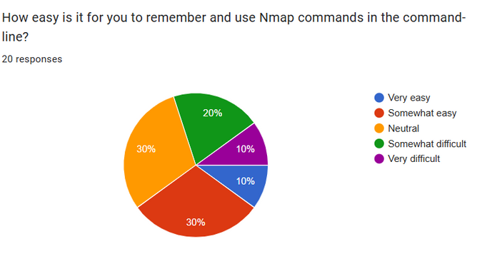
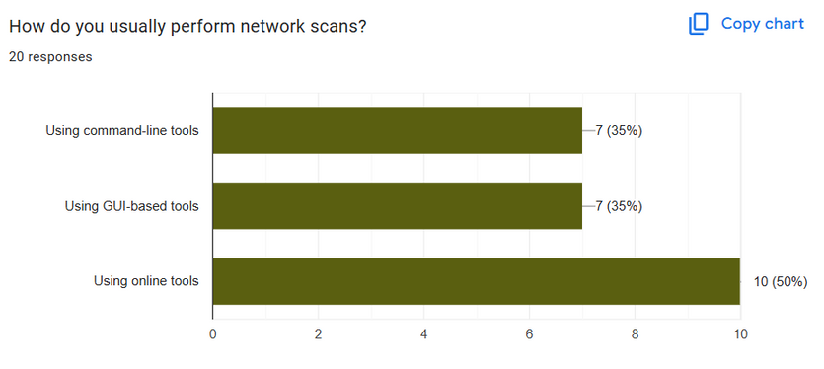
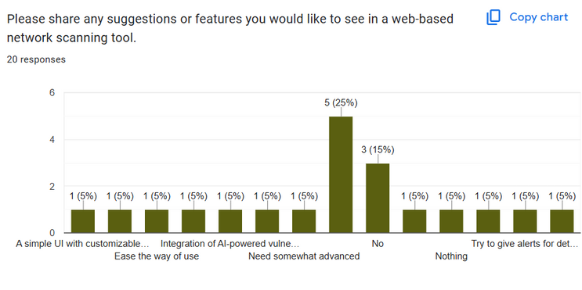
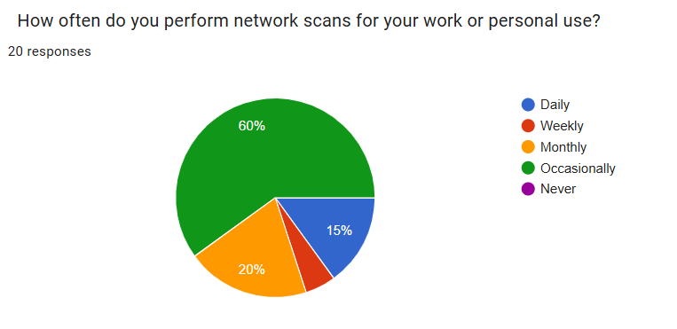
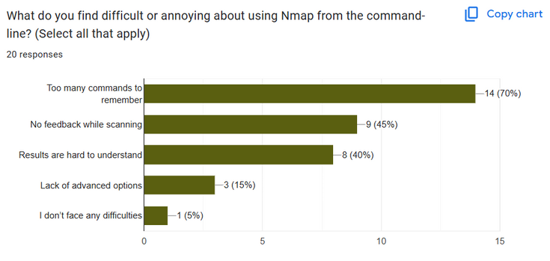
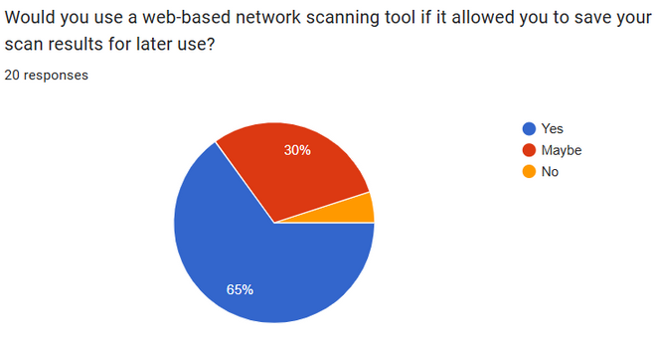
2. Product based Survey
Fig 2.1
Fig 2.2
Fig 2.3
Fig 2.4
Fig 2.5
Fig 2.6
4
08/03/2025

Slide 5
3.PROBLEM DEFINITON
Nmap, while powerful, is complex for non-technical users, requiring command-line expertise. Manual scanning is time-consuming and error-prone, lacking automation. Users need a simple, user-friendly web-based tool with customizable scan options and scan history storage for easier vulnerability detection and security analysis.
Clarity & Insight: Clearly identifies challenges non-technical users face with Nmap.
Alignment with Customer Needs: Emphasizes usability, automation, and accessibility.
Precision & Focus: Pinpoints specific pain points like manual effort, lack of customization, and missing scan history.
6
08/03/2025

Slide 6
4. CONCEPT DEVELOPMENT
Core Features & Innovation:
Advanced Crime Prediction: Uses ML algorithms (RNNs, CNNs) to forecast potential crime locations and trends.
Real-Time Monitoring: Live crime tracking with GIS-based mapping.
AI-Powered Analysis: GPT-4 for NLP-based crime reports and suspect profiling.
Heatmap Visualization: KDE and NNI for hotspot identification.
User-Friendly Dashboard: Intuitive interface for law enforcement use.
Technical Feasibility:
Machine Learning Models: Trained using historical crime data for accurate predictions.
GIS & Mapping: Seamless integration with geographic data for visual insights.
Cloud & Edge Computing: Enables scalability and real-time data processing.
Security & Privacy: Ensures ethical AI use, encryption, and compliance with legal standards.
5
08/03/2025

Slide 7
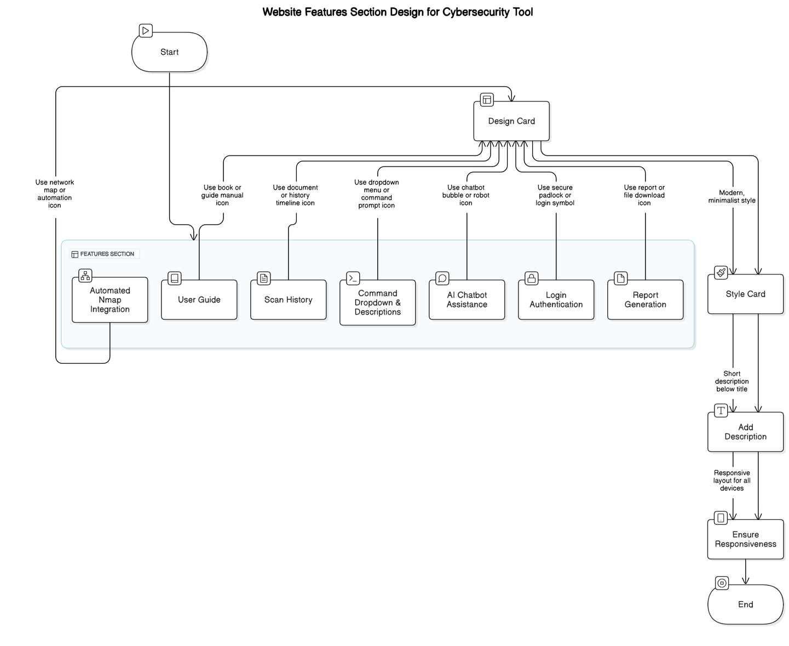
4. CONCEPT DEVELOPMENT
Why This Concept Works?
Addresses a Critical Issue: Helps law enforcement take proactive measures.
Data-Driven Decision Making: Provides actionable insights to authorities.
Scalable & Adaptable: Can be expanded to different locations and crime types.
Enhances Public Safety: Reduces crime rates by enabling preventive strategies.
5
08/03/2025

Slide 8
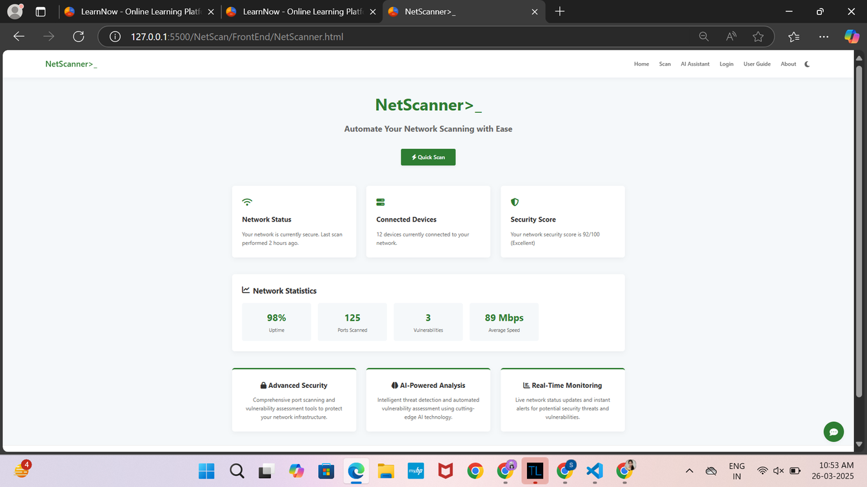
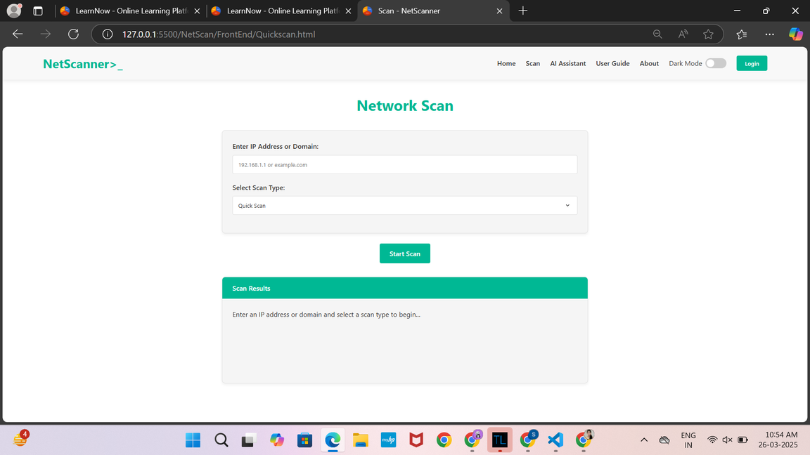
5.IMPLEMENTATION
Home Page
Quick Scan Page
Fig 5.1.2
Fig 5.1.1
7
08/03/2025

Slide 9
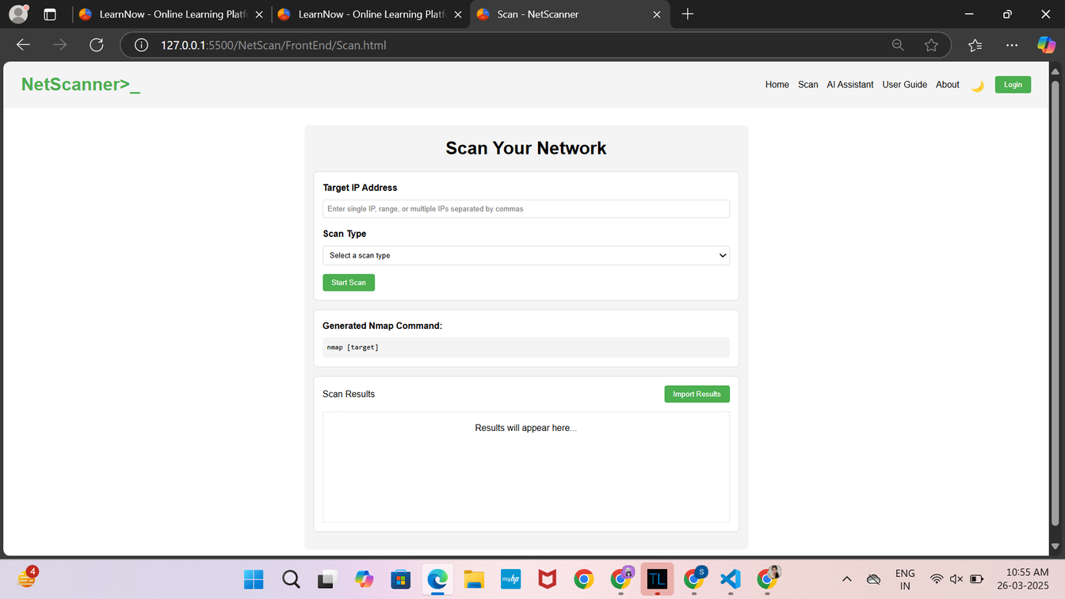
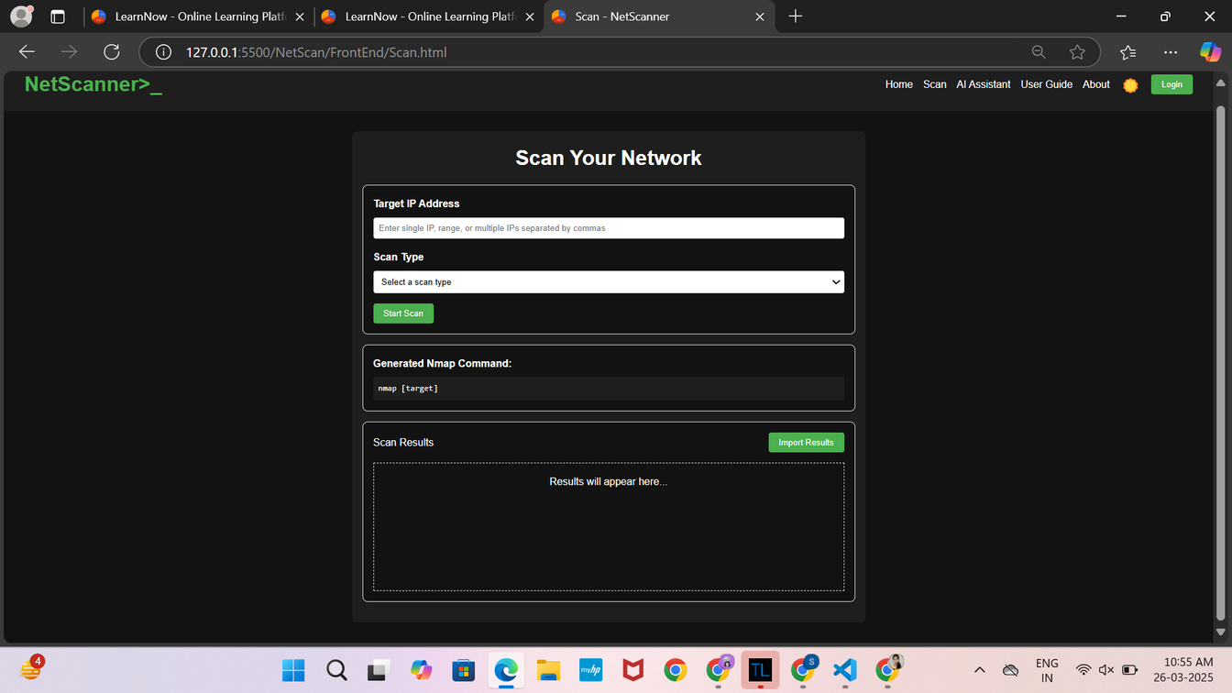
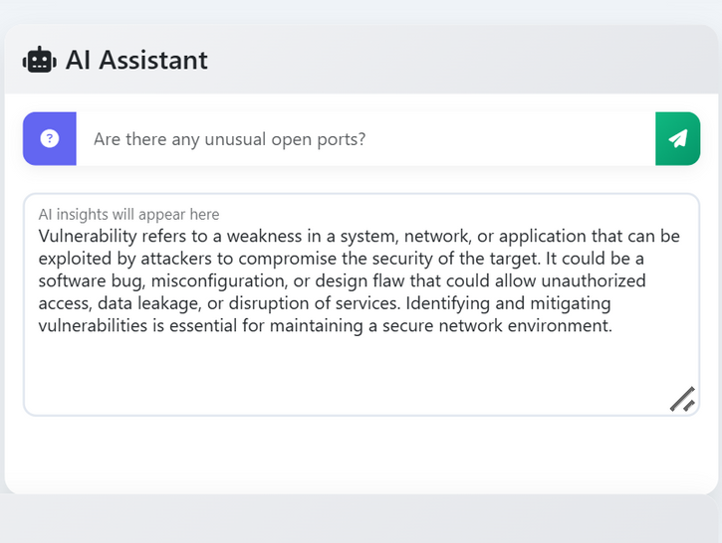
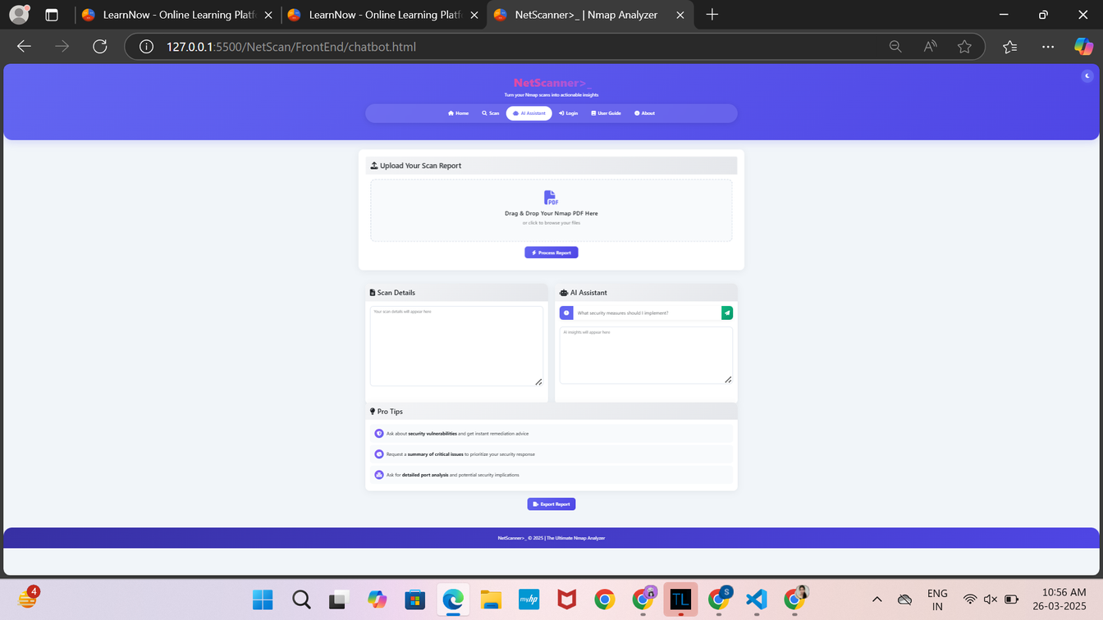
Fig 5.1.3
Fig 5.1.4
25/01/2025
8
Fig 5.1.5
Fig 5.1.6

Slide 10
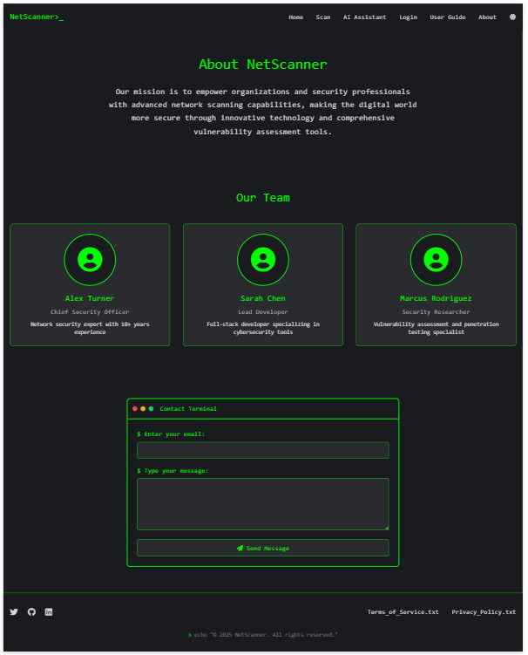
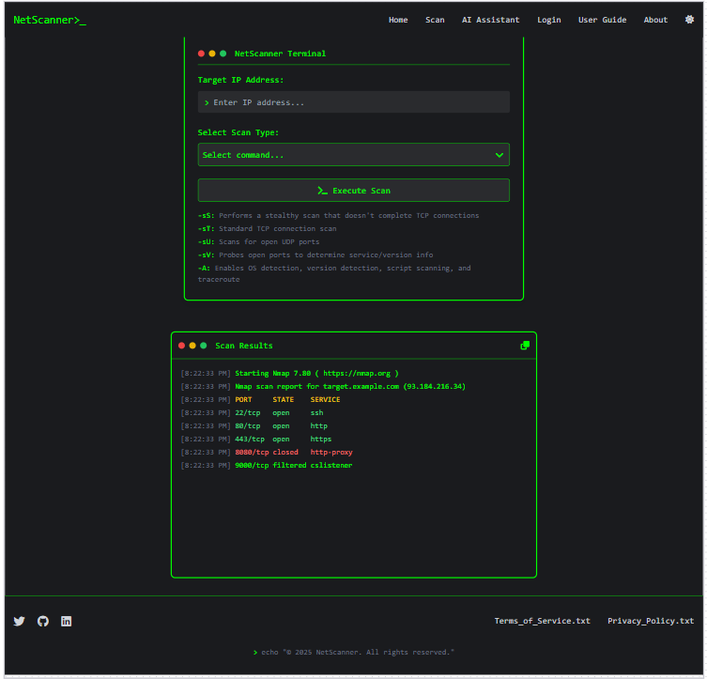
About Page
Scan Result
Fig 5.1.7
Fig 5.1.8
9
08/03/2025

Slide 11
THANK YOU
14
25/01/2025

